Slide 1
PRESENTATION TITLE
Mirjam Nilsson

Slide 2
TIMELINE
Q1
About data
Q2
Coordinate e-business applications
Q3
Deploy strategic networks with compelling e-business needs
Q4
Disseminate standardized metrics

Slide 3
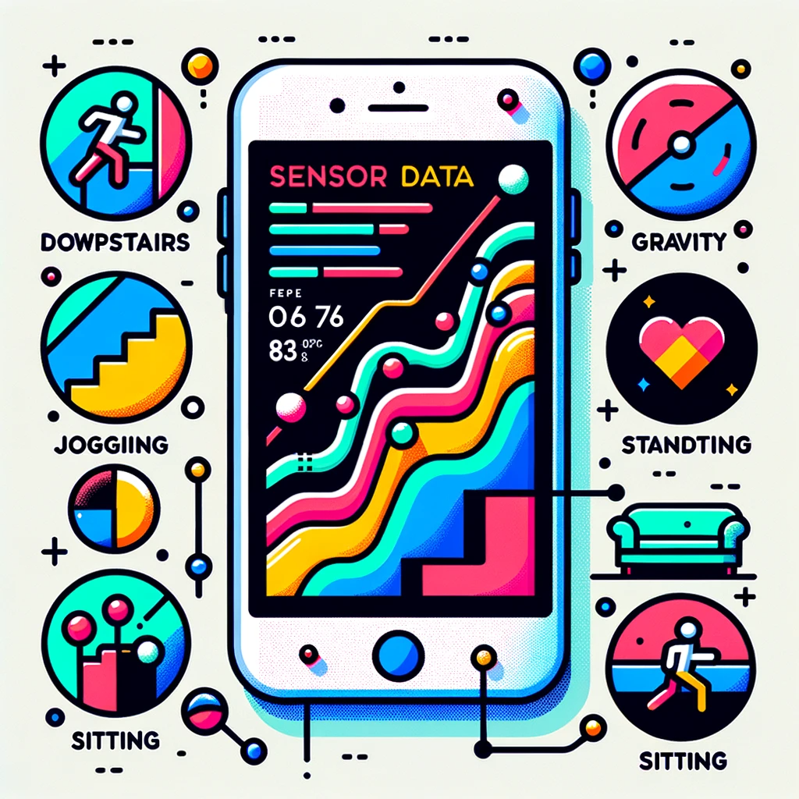
The MotionSense Dataset is a collection of time-series sensor data generated from accelerometer and gyroscope sensors on an iPhone 6s. The dataset is aimed at human activity and attribute recognition. It comprises data from 24 participants who performed 6 different activities: walking downstairs, walking upstairs, walking, jogging, sitting, and standing. The participants carried the phone in their front trouser pocket during the activities. The data consists of 15 trials with both long (2-3 minutes) and short (30 seconds to 1 minute) durations.
The dataset provides a rich set of features including attitude (roll, pitch, yaw), gravity (x, y, z), rotation rate (x, y, z), and user acceleration (x, y, z). It distinguishes between gravity and user acceleration, allowing for more accurate activity and attribute recognition. The dataset is intended for research in identifying personal attributes and different types of human activities.
This dataset serves as a valuable resource for those interested in activity recognition, sensor data analysis, and machine learning applications. If used, the authors request citing a specific paper.
Notes:
MotionSense Dataset : Smartphone Sensor Data - HAR (kaggle.com)
About Dataset
MotionSense Dataset: Sensor Based Human Activity and Attribute Recognition
Context
This dataset includes time-series data generated by accelerometer and gyroscope sensors (attitude, gravity, userAcceleration, and rotationRate). It is collected with an iPhone 6s kept in the participant's front pocket using SensingKit which collects information from Core Motion framework on iOS devices. A total of 24 participants in a range of gender, age, weight, and height performed 6 activities in 15 trials in the same environment and conditions: downstairs, upstairs, walking, jogging, sitting, and standing. With this dataset, we aim to look for personal attributes fingerprints in time-series of sensor data, i.e. attribute-specific patterns that can be used to infer gender or personality of the data subjects in addition to their activities.
A simple code for importing dataset and to get your hands in
Content
For each participant, the study had been commenced by collecting their demographic (age and gender) and physically-related (height and weight) information. Then, we provided them with a dedicated smartphone (iPhone 6) and asked them to store it in their trousers' front pocket during the experiment. All the participant were asked to wear flat shoes. We then asked them to perform 6 different activities (walk downstairs, walk upstairs, sit, stand and jogging) around the Queen Mary University of London's Mile End campus. For each trial, the researcher set up the phone and gave it to the current participants, then the researcher stood in a corner. Then, the participant pressed the start button of Crowdsense app and put it in their trousers' front pocket and performed the specified activity. We asked them to do it as natural as possible, like their everyday life. At the end of each trial, they took the phone out of their pocket and pressed the stop button. The exact places and routes for running all the activities are shown in the illustrative map in the following Figure.
As we can see, there are 15 trials:
Long trials: those with number 1 to 9 with around 2 to 3 minutes duration.
Short trials: those with number 11 to 16 that are around 30 seconds to 1 minutes duration.
There are 24 data subjects. The A_DeviceMotion_data folder contains time-series collected by both Accelerometer and Gyroscope for all 15 trials. For every trial we have a multivariate time-series. Thus, we have time-series with 12 features: attitude.roll, attitude.pitch, attitude.yaw, gravity.x, gravity.y, gravity.z, rotationRate.x, rotationRate.y, rotationRate.z, userAcceleration.x, userAcceleration.y, userAcceleration.z.
The accelerometer measures the sum of two acceleration vectors: gravity and user acceleration. User acceleration is the acceleration that the user imparts to the device. Because Core Motion is able to track a device’s attitude using both the gyroscope and the accelerometer, it can differentiate between gravity and user acceleration. A CMDeviceMotion object provides both measurements in the gravity and userAcceleration properties. (More info)
There are 6 different labels:
dws: downstairs
ups: upstairs
sit: sitting
std: standing
wlk: walking
jog: jogging
Acknowledgements
If you use this dataset, please cite the following paper:

Slide 4
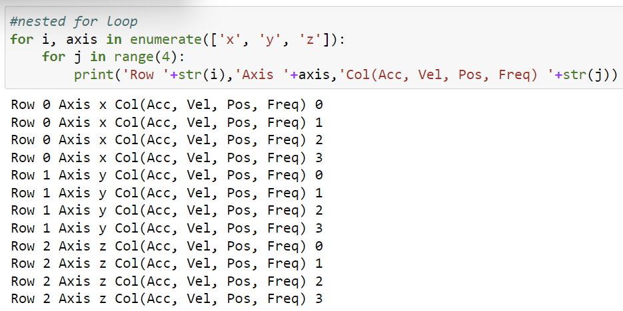
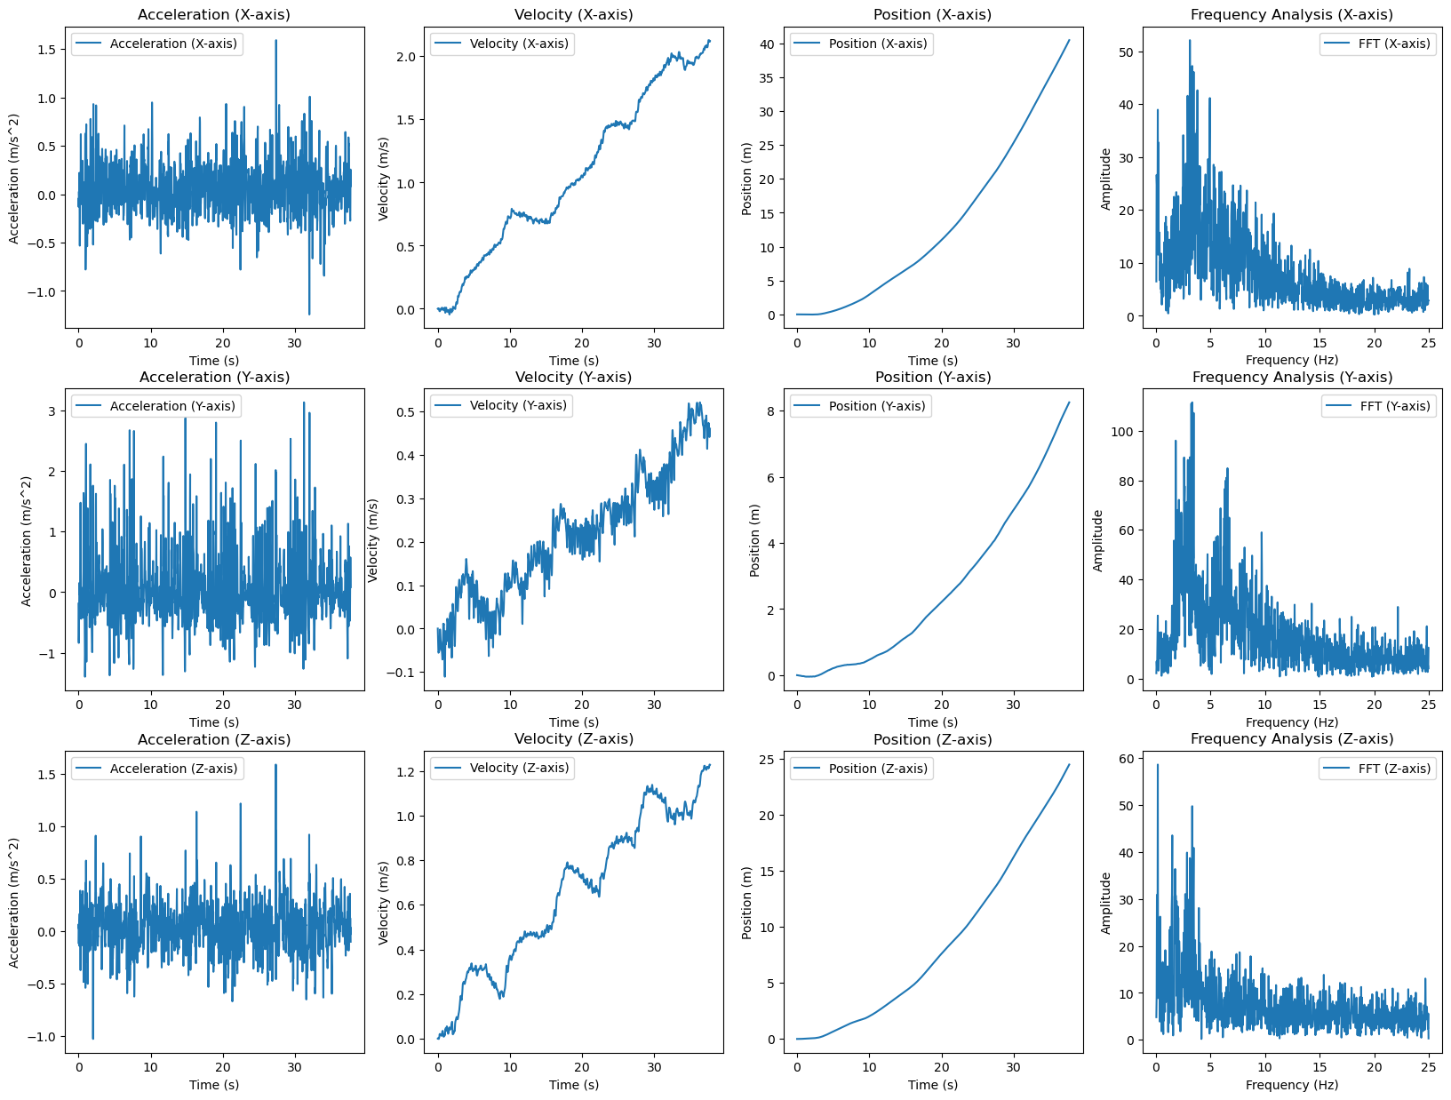
Technical part
Nested For loop to create 3 by 4 table
4th Column
1st Row
(x-axis)

Slide 5
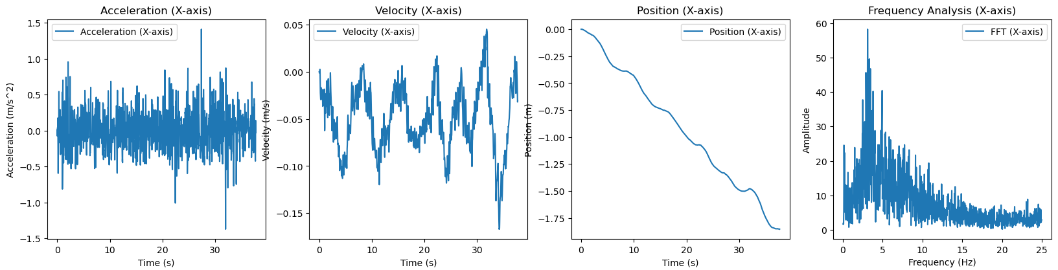
Optimization
Travel distance to X went too far
Speed is accumulating
High Pass filter

Slide 6
Optimization

Slide 7
AGENDA
Introduction
Primary goals
Areas of growth
Timeline
Summary

Slide 8
What can I do with this dataset
Category | Sub-Category | Description
Advanced Feature Engineering | Safety Monitoring | Use sensor data to detect anomalous behavior indicative of a fall or emergency. Implement real-time alerts.
 | Error-Correction and Data Smoothing | Use advanced filtering or machine learning to correct for sensor noise or errors.
Machine Learning Models | Activity Classification | Train a machine learning model to classify types of activity being performed.
 | User Identification | Use walking patterns to uniquely identify the user.
Simulation and Visualization | 3D Modeling | Create a 3D model of the movement for better spatial understanding.
 | Real-Time Dashboard | Create a real-time dashboard to display metrics and include abnormal pattern alarms.
Personalized Analysis | Biomechanical Modeling | Use weight and height to create a more accurate biomechanical model of movement.
 | Age/Gender-Based Insights | Analyze movement patterns across different age groups and genders.
Advanced Machine Learning | Predictive Modeling | Use demographic features to improve machine learning model accuracy.
 | Health Metrics | Use these metrics to estimate calorie burn or fatigue levels.
Visualization and Reporting | Demographic Segmentation | Create visualizations segmented by age, gender, or other demographic factors.
 | Interactive Dashboard | Build an interactive dashboard that allows data and insights filtering by individual or demographic group.

Slide 9
INTRODUCTION
At Contoso, we empower organizations to foster collaborative thinking to further drive workplace innovation. By closing the loop and leveraging agile frameworks, we help business grow organically and foster a consumer-first mindset.​

Slide 10
PRIMARY GOALS
Annual revenue growth

Slide 11
AREAS OF GROWTH
​ | CATEGORY 1 | CATEGORY 2 | CATEGORY 3​ | CATEGORY 4​
Q1 | 4.5​ | 2.3​ | 1.7​ | 5​.0
Q2 | 3.2​ | 5.1​ | 4.4​ | 3​.0
Q3 | 2.1​ | 1.7​ | 2.5​ | 2.8​
Q4 | 4.5​ | 2.2​ | 1.7​ | 7.0

Slide 12
BUSINESS OPPORTUNITIES ARE LIKE BUSES. THERE'S ALWAYS ANOTHER ONE COMING.​
Richard Branson

Slide 13




MEET OUR TEAM
TAKUMA HAYASHI
MIRJAM NILSSON
FLORA BERGGREN
RAJESH SANTOSHI
President
Chief Executive Officer
Chief Operations Officer
VP Marketing

Slide 14







MEET OUR TEAM
TAKUMA HAYASHI
MIRJAM NILSSON
RAJESH SANTOSHI
RAJESH SANTOSHI
President
Chief Executive Officer
Chief Operations Officer
VP Marketing
GRAHAM BARNES
ROWAN MURPHY
ELIZABETH MOORE
ROBIN KLINE
VP Product
SEO Strategist
Product Designer
Content Developer

Slide 15
PLAN FOR PRODUCT LAUNCH
Deploy strategic networks with compelling e-business needs
PLANNING
Synergize scalable e-commerce
MARKETING
Disseminate standardized metrics
DESIGN
Coordinate e-business applications
Foster holistically superior methodologies
LAUNCH
STRATEGY

Slide 16
AREAS OF FOCUS
B2B MARKET SCENARIOS
CLOUD-BASED OPPORTUNITIES
Develop winning strategies to keep ahead of the competition
​Capitalize on low-hanging fruit to identify a ballpark value
​Visualize customer directed convergence​
Iterative approaches to corporate strategy
​Establish a management framework from the inside​

Slide 17
HOW WE GET THERE
ROI
NICHE MARKETS
SUPPLY CHAINS
Envision multimedia-based expertise and cross-media growth strategies​
​Engage worldwide methodologies with web-enabled technologies​
Pursue scalable customer service through sustainable strategies​
Engage top-line web services with cutting-edge deliverables​​​
Cultivate one-to-one customer service with robust ideas​
Maximize timely deliverables for real-time schemas​

Slide 18
SUMMARY
At Contoso, we believe in giving 110%. By using our next-generation data architecture, we help organizations virtually manage agile workflows. We thrive because of our market knowledge and great team behind our product. As our CEO says, "Efficiencies will come from proactively transforming how we do business."​

Slide 19
THANK YOU
Mirjam Nilsson
mirjam@contoso.com
www.contoso.com

